Slide 1
Gathering Insights from Movie Reviews with Text Processing and AI
BUAN 6390.001 - Analytics Practicum - F25
Group 6
Priyadarshan Parida
Sunayana Jana
Soniya Rajappan
Notes:
Good moring, good afternoon. We are Group 6 — I am Priyadarshan, and we are joined by Sunayana, and Soniya. Today we’ll walk you through our KNIME-based implementation on analyzing movie reviews using both Traditional Machine Learning and Generative AI.

Slide 2



Problem Statement & Objectives
Problem Statement
Over 80% of viewers check reviews before watching a movie
Streaming platforms depend heavily on user reviews for rankings & recommendations
Movie reviews are unstructured, subjective, and often inconsistent
Need a scalable approach to analyze thousands of reviews efficiently
KNIME for text processing, ML clustering, and GenAI sentiment; delivered insights through Data App
Why It Matters
Helps studios and platforms improve recommendations, marketing, and content decisions
Research Questions
How do ML and GenAI differ in sentiment accuracy and what reviewer clusters and movie patterns emerge?
Compare ML and GenAI sentiment
Measure sentiment-model effectiveness
Segment reviewers by text patterns
Identify distinct taste clusters
Scope & Assumptions
Insights focus on text patterns; no genre data available; sentiment assumed to reflect true opinions
Key Comparison Criteria
Accuracy, Precision, F-score, Recall, Segment distribution and Word-cloud,
Rank movies using sentiment scores
Identify top and bottom 10 movies
Build KNIME Data App
Summarize insights for decisions
Notes:
Movie reviews play a major role in how viewers choose what to watch — over 80% viewers consult them before deciding. But reviews are unstructured, subjective, and inconsistent.
Our goal in this project was to transform thousands of raw reviews into meaningful insights using KNIME. We framed the project with key research questions:
How do ML and GenAI compare in accuracy and interpretation for sentiment analysis?
What reviewer clusters naturally emerge?
And what traits distinguish the top movies from the bottom ones?

Slide 3







Methodology Snapshot
IMDB Data Ingestion
Text Clean-up & Normalization
Traditional ML Sentiment Analysis
GenAI Sentiment & Aspects Analysis
Reviewer Segmentation
KNIME Data App & Insight Summary
Text Processing
Traditional ML
Generative AI
Data App
Stopword Filter, Snowball Stemmer, BoW, TF-IDF
Naïve-Bayes, SVM, Logistic Regression, k-Means
OpenAI Authenticator, LLM Selector, LLM Prompter
Bar charts, Heatmaps, Components
Traditional ML Interpretable and lightweight, easy to audit and scalable models.
Tools Used
GenAI captures latent semantic relationships using LLM-derived contextual embeddings.
Clean and structure raw text for analysis
Sentiment scoring and reviewer segmentation
General and Aspect-based-sentiment-analysis and insights
Deliver insights through dashboard
Purpose
Comparison ensures holistic solution that can be adopted based on purpose and ROI.
Notes:
On this slide we show our end to end workflow.
We began by ingesting, exploring and cleaning the IMDB reviews dataset.
We also addressed some data quality issue during this process. For instancee, the first sentence of every review was repeated at the bottom, which lead to inaccurate model weights. We corrected the problem using regular expressions and string manipulation.
Next, we ran the text preprocessing and then implemented sentiment classification and reviewer segmentation on parallel tracks using ML models and Generative AI.
Naïve Bayes, SVM, and Logistic Regression ML models were used for sentiment classification.
On a parallel track, we used the GPT-4 model through LLM Prompter and OpenAI nodes to implement GenAI-based sentiment and aspect extraction.
For reviewer segmentation on the ML track, we used SVD for dimensionality reduction, followed by K-Means for clustering. On the GenAI track, we used GPT-4 and context embeddings to cluster reviewers and extract the clustering basis.
Finally, we brought everything together in Data App using components.
With that, I’ll turn it over to Soniya to take us further.

Slide 4
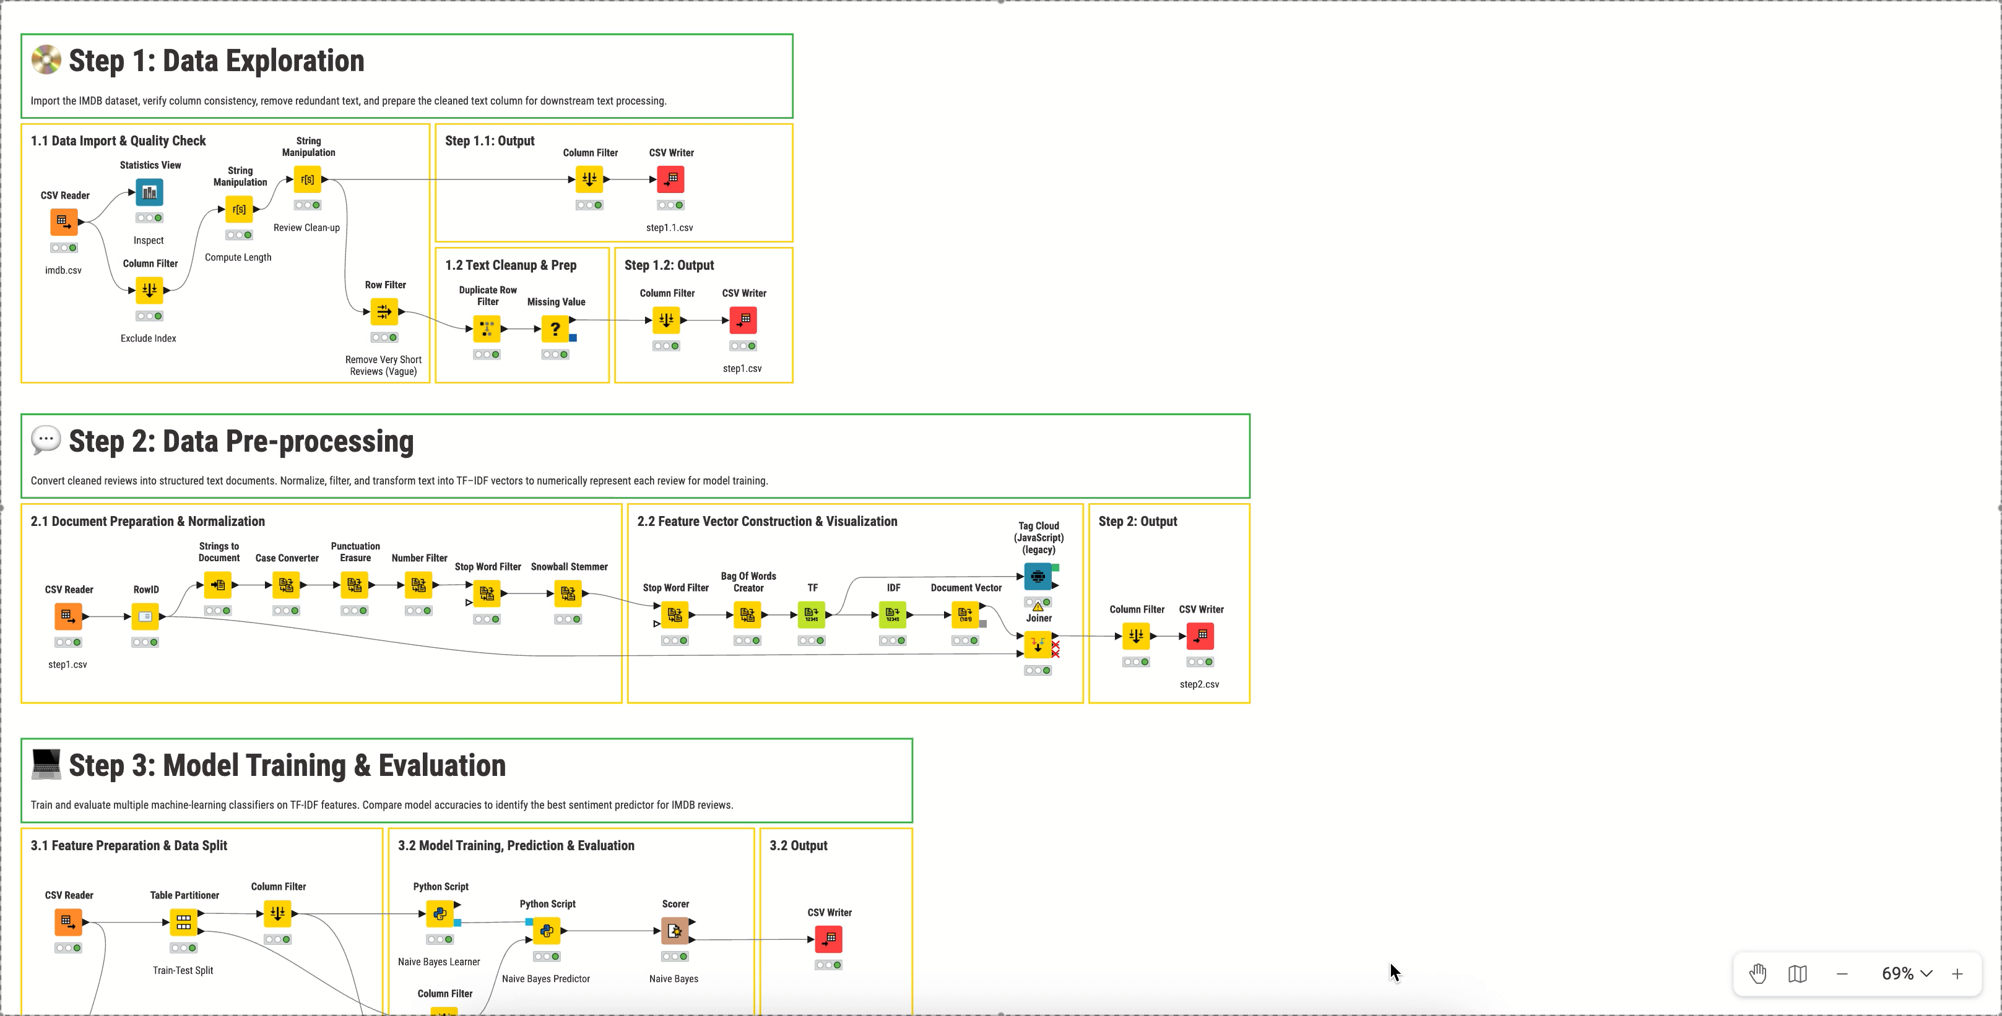
KNIME Workflow

Slide 5
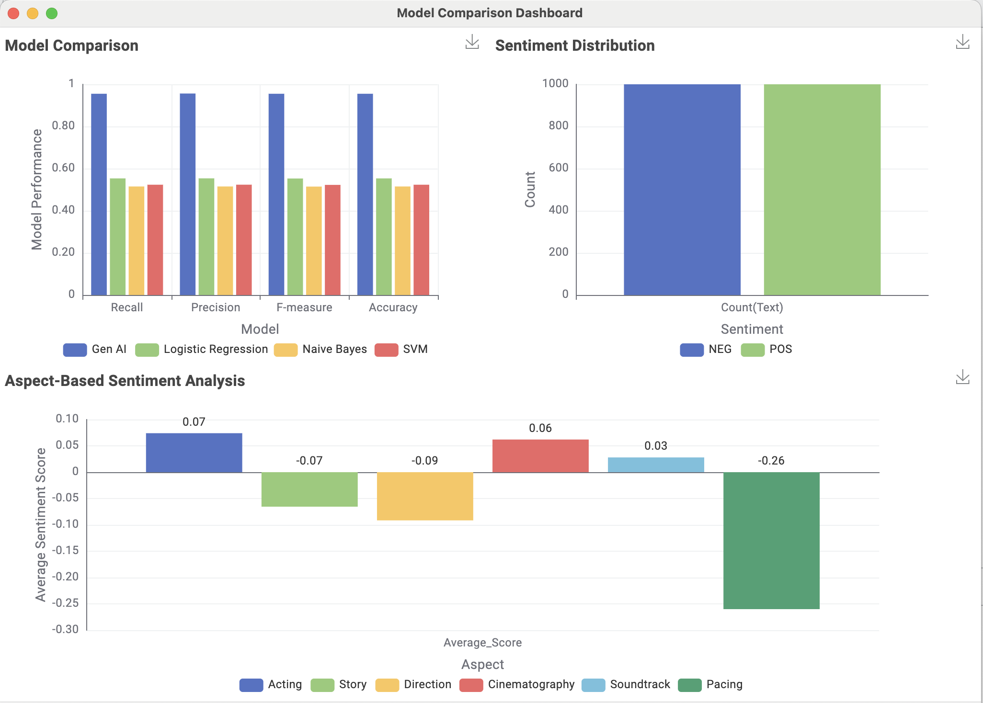
Traditional ML vs Generative AI – Model Comparison
Key Insights
GenAI achieved 90%+ accuracy, outperforming all ML models
(48–53%)
Traditional ML had limited capability with interpreting deeper semantics
GenAI captured thematic nuance and inferred sentiment effectively
Balanced dataset rules out any performance gaps due to class imbalance
Aspect analysis: Acting & Cinematography positive, Pacing strongly negative
ML offers a simple, fast baseline; GenAI for depth and accuracy

Slide 6
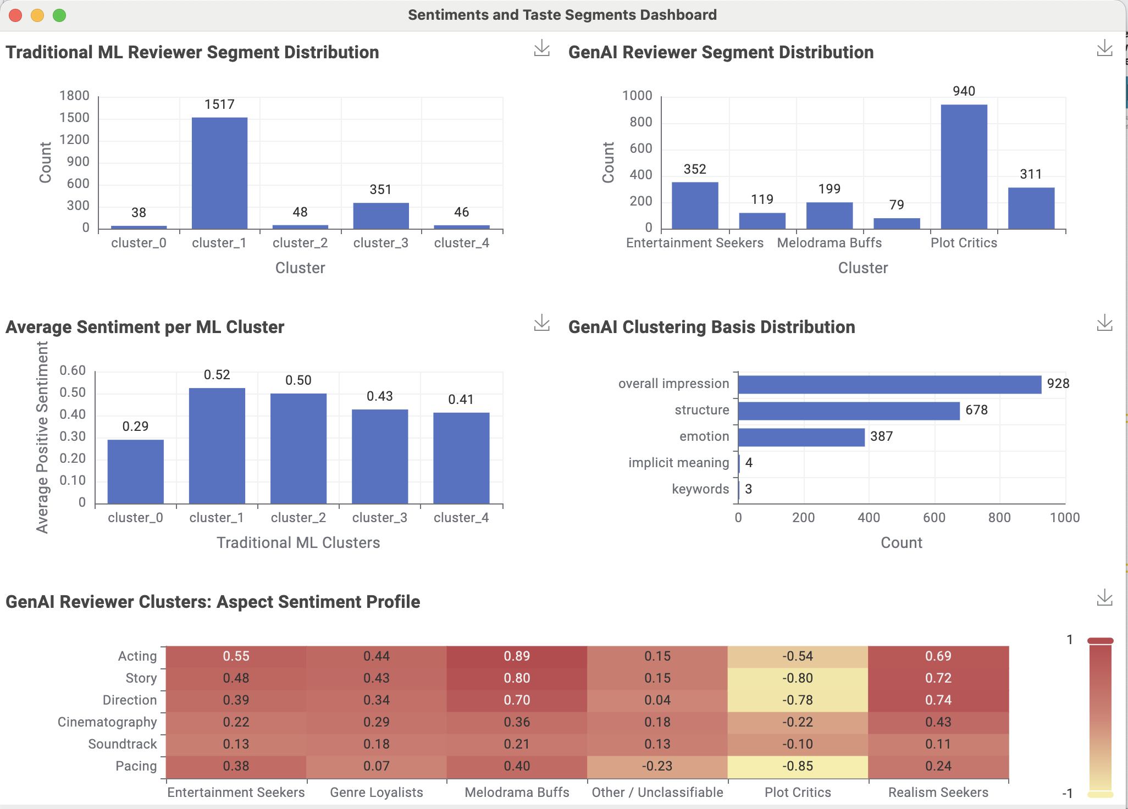
Sentiments and Taste Segments
Key Insights
Traditional ML based clustering missed most of the semantic context leading to misclassification
GenAI produces clearer, interpretable reviewer personas - Entertainment Seekers, Melodrama Buffs, etc.
GenAI based clustering was backed by meaningful clustering basis
Sentiment varies strongly across ML clusters (0.29–0.52 spread)
Aspect profiles reveal what each segment values. Melodrama Buffs love Acting; Plot Critics dislike Pacing
Plot Critics consistently score lowest across aspects
Notes:
Moving on to segmentation - On this slide we are comparing the different taste segments identified by Traditional ML and Generative AI.
Traditional ML clustering produced uneven clusters, with one large dominating cluster.
GenAI clustering produced clear, interpretable reviewer personas like Entertainment Seekers, Melodrama Buffs, and Plot Critics.

Slide 7
Sentiments and Taste Segments
Key Insights
Traditional ML based clustering missed most of the semantic context leading to misclassification
GenAI produces clearer, interpretable reviewer personas - Entertainment Seekers, Melodrama Buffs, etc.
GenAI based clustering was backed by meaningful clustering basis
Sentiment varies strongly across ML clusters (0.29–0.52 spread)
Aspect profiles reveal what each segment values. Melodrama Buffs love Acting; Plot Critics dislike Pacing
Plot Critics consistently score lowest across aspects
Notes:
Going back to the dashboard As you can see in the highlighted green box, keywords sit at the bottom of the factors GenAI uses for clustering.
Also, sentiments varied strongly across these groups — with Plot Critics being heavily represented
among negative reviews, as you can see in the heatmap.

Slide 8
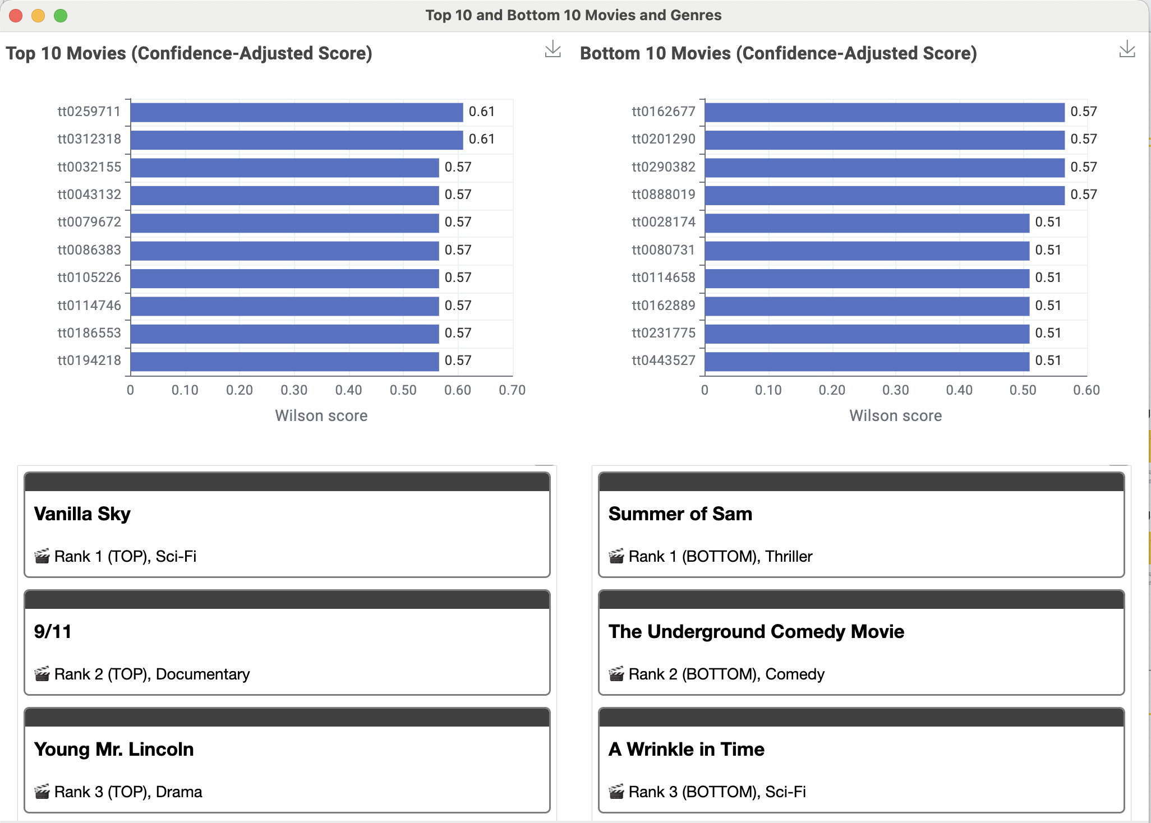
Top 10 and Bottom 10 Movies and Genres
Key Insights
Top movies maintain higher Wilson scores (0.57 – 0.61)
Wilson score adjusts for rating confidence, ranking movies more reliably
Top 10 movies span multiple genres, showing broad positive reception
Bottom 10 movies concentrate in Comedy and Horror genres
Drama dominates the top group with four strong titles
Horror appears four times in the bottom group
Notes:
Next
We used Wilson scores to rank the top and bottom 10 movies, as it adjusts for rating confidence and sample size, giving a more reliable ranking than simple averages. We found that top movies maintain stronger Wilson scores in the 0.57–0.61 range, while bottom movies cluster lower.
Top movies also span multiple genres — SciFi, Drama, Documentary, Action — showing broad appeal. While bottom movies are mostly Comedy and Horror, which are highly taste-dependent.

Slide 9
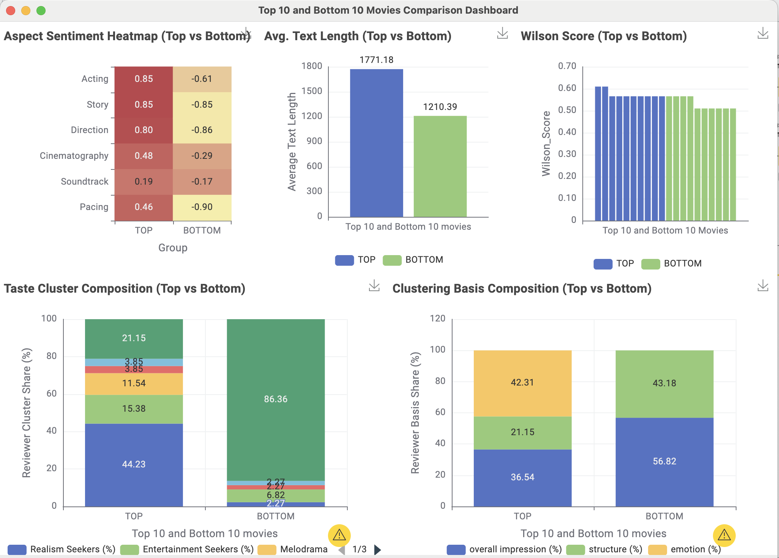
What Distinguishes Top vs Bottom Movies?
Key Insights
Top movies score higher across every aspect sentiment - Acting, Story, Direction all strongly positive
Bottom movies show negative sentiment across all aspects - Pacing, Story, Direction esp. low
Top movies receive longer, more detailed reviews (~1771 vs ~1210 words)
Bottom movies attract far more Plot Critics (86% vs 21%)
Top movies attract more diverse reviewer segments
Top movies show 42% emotion; bottom movies show virtually 0%
Notes:
Next
When we compare the top and bottom movies side-by-side, several clear patterns emerge:
Top movies score higher across every aspect sentiment — especially Acting and Story.
Bottom movies score negative on most aspects, with Pacing being the most negative.
Top movies attract diverse reviewer segments, while Bottom movies attract a large share of Plot Critics.
Review length also differs: top movies receive richer, longer reviews; bottom movies get shorter, surface-level ones.
One striking result was that the top 10 movies had 42% emotion-driven reviews, while bottom movies had 0% emotion, relying instead on overall impression or structural critique.

Slide 10
Key Takeaways & Insights
Sentiment Understanding
GenAI revealed deeper tone, nuance, and emotional patterns across reviews.
Aspect Advantage
Reviewer Behavior
1
GenAI enabled aspect-level sentiment (Acting, Story, Direction, Cinematography, Soundtrack, Pacing), impossible with ML.
2
Top movies attracted diverse, emotionally engaged reviewers; bottom movies attracted more Plot Critics.
Taste Segmentation
GenAI clusters produced clear reviewer personas; ML clusters were uneven.
Genre Patterns
Text Depth
3
4
Movie-Level Signals
Top movies showed stronger Acting/Story sentiment; bottom movies weaker overall.
Top movies spanned many genres; bottom movies centered on Comedy and Horror.
Top movies received longer, richer reviews; bottom movies shorter and surface-level.
Notes:
Next
To wrap up:
GenAI revealed deeper sentiment, nuance, and emotional signals and produced clusters that reflected clearer reviewer personas than ML.
Reviewer behavior, aspect-level sentiment, text depth, and genre distribution all contributed to the distinctions we observed.
Overall, combining ML and GenAI in KNIME gave us much richer, more reliable insights than either method alone.

Slide 11
Thank You!
Notes:
And with that, we’ve reached the end of our presentation. Thank you.

Slide 12
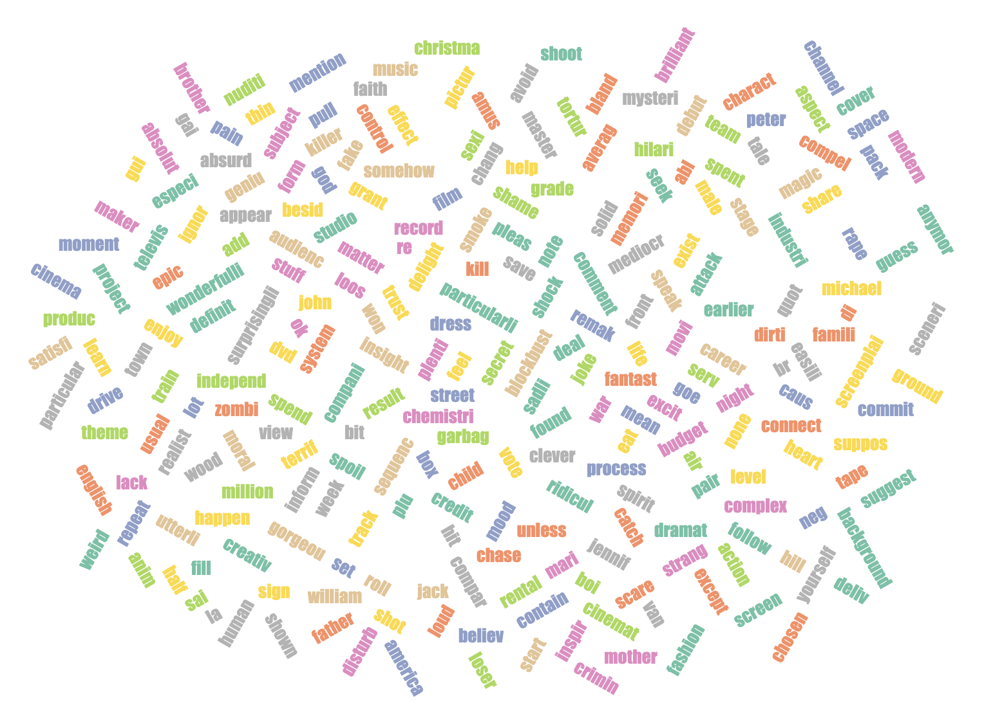
Traditional ML Based Clustering
Cluster | Label | High-Weight Words | Interpretation
Cluster 0 | Mainstream Enthusiasts | film, watch, time, love, act | Seek balanced enjoyment – acting + story + pace. Represent general audience taste.
Cluster 1 | Realism Seekers | real, life, people, character, story | Prefer believable, human stories and emotional authenticity.
Cluster 2 | Plot Critics | plot, scene, story, bad, waste | Judge movies on narrative logic & writing quality.
Cluster 3 | Melodrama Buffs | recommend, music, perfect, real, laugh | React to emotional and musical resonance; value warmth and connection.
Cluster 4 | Entertainment Seekers | fun, laugh, action, recommend, enjoy, watch | Care most about humor, pace, and excitement – the “fun factor.”
Notes:
Next We are showing how we labeled the ML-based clusters using the highest-weighted words within each cluster. However, traditional ML models have limited ability to process semantics and capture variations in natural language, as is evident from teh word cloud. As a result, the cluster boundaries are often unclear, and some clusters end up misrepresented.

Slide 13
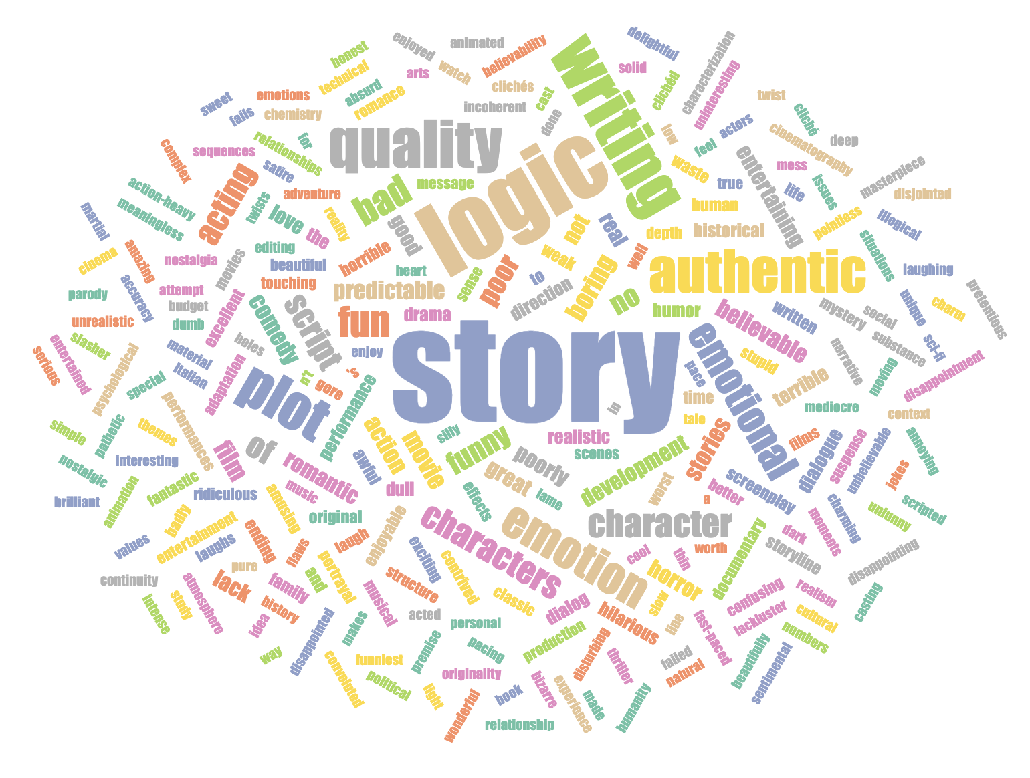
GenAI Based Clustering
Cluster | Label | Top Key Words | Interpretation
1 | Entertainment Seekers | fun, entertaining, comedy, hilarious, action, laugh, enjoyable, exciting, humor | Care most about humor, pace, and excitement – the “fun factor.”
2 | Genre Loyalists | horror, sci-fi, Star Trek, animation, fantasy, anime, classic, comedy, low budget, martial arts | Consistently praise or criticize specific genres (e.g., horror, comedy, sci-fi, romance).
3 | Melodrama Buffs | emotional, romantic, love, emotional stories, romance, love story, touching, beautiful, emotion, heartwarming | Drawn to emotional, romantic, or inspirational films with strong feelings or music.
4 | Plot Critics | story logic, writing quality, boring, story, character development, predictable, script, plot, bad acting, characters | Focus on story logic, writing quality, and script coherence.
5 | Realism Seekers | authentic emotion, authentic, believable stories, documentary, realistic, believable, realism, true story, emotional, real | Value believable stories, authentic emotion, and human characters.
6 | Others | bizarre, disturbing, nostalgia, historical context, interpretation, low budget, psychology, spoof, weird
Notes:
Next On this slide, we draw parallels by representing the top keywords for each GenAI cluster. GenAI goes far beyond keyword matching—its clustering is driven by deeper semantic relationships.

